Slide 1

Linear Regression - I

Slide 2
What is a Simple Linear Regression?
A Simple linear regression is an approach (basically a function) for predicting a quantitative response variable (Y) on the basis of a single predictor variable (X).
Just like y = mx+b, which is used to predict (Y) along a straight line, a simple regression has the form
Y ≈ β₀ + β₁X + ε
Just like (m), (β₁) is the slope intercept and is defined by (ΔY/ΔX). Just like (b), β₀ is the intercept.
Mostly, we use the notation yˆ = βˆ₀ + βˆ₁ x , where each “hat” indicates a sample estimate of the true population value.

Slide 3

So what are our goals
Our primary task is to calculate a ‘robust’ βˆ₁ . Robust here means that a) the slope coefficient should have the correct sign (if Y is weight and X is height, there should be a positive relationship, a positive coefficient) and b) statistically significant.
We will accomplish this by using the Ordinary Least Squares (OLS). OLS is a regression estimation technique that calculates the βˆ􏱅s so as to minimize the sum of the squared residuals. That is,
Wait. What are sum of squared residuals?? Lets visualize!!

Slide 4
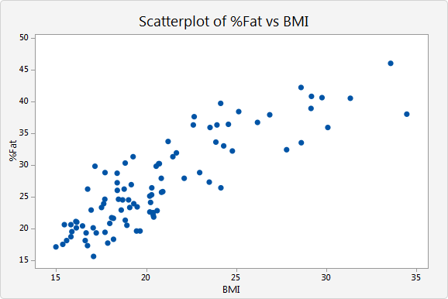
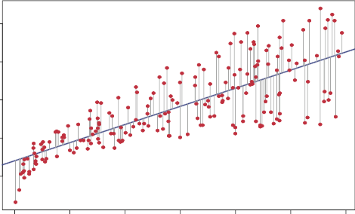
BMI vs. Fat % for an individual
yˆ􏱅
y_{actual}
Residuals are the perpendicular distances between yˆ􏱅 and y_{actual}

Slide 5


RSS: Residual sum of Squares
So when we say that OLS minimizes e², we are trying to find a straight line that minimizes the residuals (e_{i} = y_{i} − yˆ_{i})or perpendicular distances between the actual observations and our line of best fit.
We define the residual sum of squares (RSS) as RSS = e²₁ + e²₂ + … + e²_{n}
We can further elaborate by substituting (yˆ = βˆ₀ + βˆ₁ x) into e_{i}; RSS=(y₁−βˆ₀−βˆ₁x₁)² + (y₁−βˆ₀−βˆ₁x₂)² + …+ (y₁−βˆ₀−βˆ₁x_{n})²
So we use OLS to calculate βˆ₀ and βˆ₁ such that
After taking partial derivatives, we find
Notes:
Derivation availble at https://are.berkeley.edu/courses/EEP118/current/derive_ols.pdf

Slide 6
Lets do a problem by hand
OBS X_(inches above 5ft) Y_(lbs) 1 5 140 2 9 157 3 13 205 4 12 198 5 10 162 6 11 174 7 8 150 8 9 165 9 10 170 10 12 180
90.515+8.039(8) = 147 lbs
Notes:
Equation is =

Slide 7
Interpreting the linear regression Equation
So, our answer was 90.515+8.039x. What does this mean?
βˆ₁ = 8.039 implies that a 1 inch increase in height leads to a 8 pound increase in weight. More generally, a 1 unit change in X leads to a β change in Y
When we have multiple variables, the interpretation is the same with one change: “A 1 unit change in X_{n} leads to a β_{n} change in Y, holding all other variables constant”.
If we want to understand combined effects,(for example, what is the combined effect of years of experience and centuries score on a cricketers salary? Do young player with 5 centuries get paid less than players with 8 years and 5 centuries?) we create new variables called interaction terms.

Slide 8
How reliable are our coefficient estimates?
A good βˆ₁estimate, is one that is close to the population β₁ But, as we have discussed before we can never observe the true relationship b/w (Y) and (X).
Thinking back to our discussion of sampling and estimation, one way to gauge the reliability of our coefficient is a Hypothesis Test.
Here is what the hypothesis setup would look like:
Null Hypothesis: βˆ₁ = 0 (There is no relationship between X and Y)
Alternative Hypothesis : βˆ₁ ≄0 (There is some relationship between X and Y)
Here we can use the t-test to reject or accept the null or use p-values. Luckily, statsmodel reports these for us.

Slide 9

Example of t-stat, p-value reporting
βˆ₀
βˆ₁
As you can see, both the intercept and coefficient are statistically significant at all levels of confidence and therefore the null must be rejected.

Slide 10
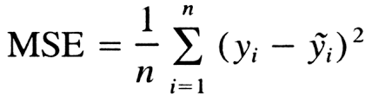
Evaluating the Regression Model
Ok, so we now have statistically significant coefficients. But a coefficient can be statistically significant but have a very low value (eg. a βˆ₁ = 0.007). This means that the coefficient for a variable is not able to explain much variation in Y.
How can we formalize how well or badly a regression predicts changes in the response variables? If we trained our model on, say, 80% of the data (training dataset) and used the other 20% to test our predictions(test dataset), we know how far away our prediction was from the true answer. This difference is our error, our measure.
We use something called the Mean Square Error (MSE) or its square root RMSE.

Slide 11

Other Measures
So a lower MSE or RMSE is obviously better than a higher value, but how low is “good”?
One way to understand how much our model has truly “learned” is by comparing RMSE of our training dataset and test dataset. While the error of the test is usually higher because there is less data, if the two values are close, we have a “good” model.
Another common measure is R², which is derived from our RSS.
R² is measures the “goodness of fit” and exists between interval 0 < R²<1

